Slide 1
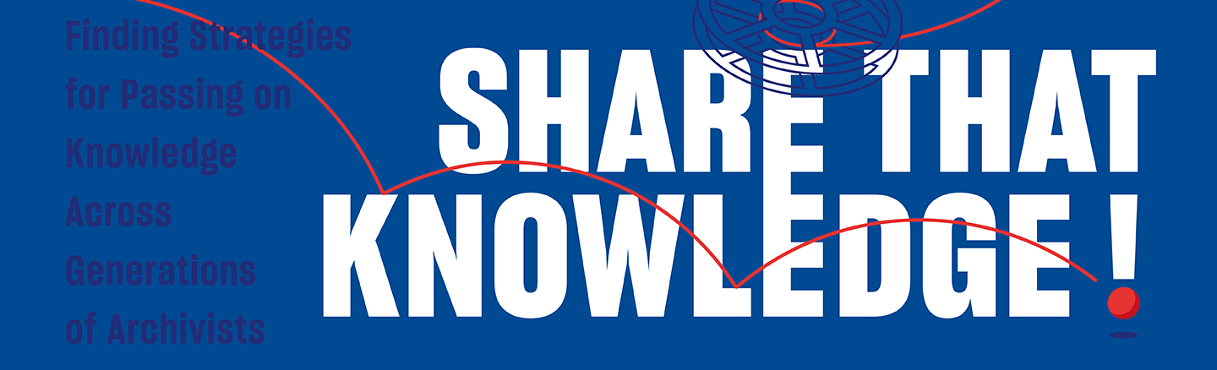
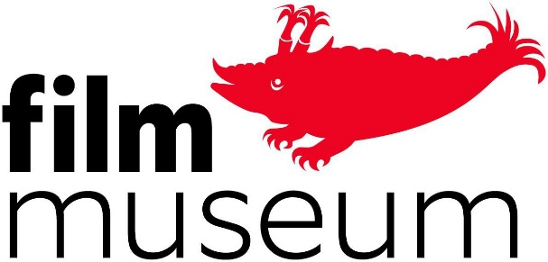
Workshop at the 54th IASA CONFERENCE & 4th ICTMD FORUM
September 14, 2023
Nadja Šičarov – Freelance archivist and restorer, Serbia/Slovenia
Janneke van Dalen – Film collection manager, Austrian Film Museum

Slide 2
Workshop: Finding methods for sharing knowledge within sound and audiovisual archives
Introduce research project "Share that Knowledge!"
  The knowledge about the collections we work with, that is with audiovisual archivists, technicians, researchers etc., is an intangible part of audiovisual heritage, but is also fragile and needs attention for it to be passed on, shared, and preserved.
Present the research outcome: a road map for knowledge sharing
Share experience about knowledge transfer, its challenges and its practices

Slide 3
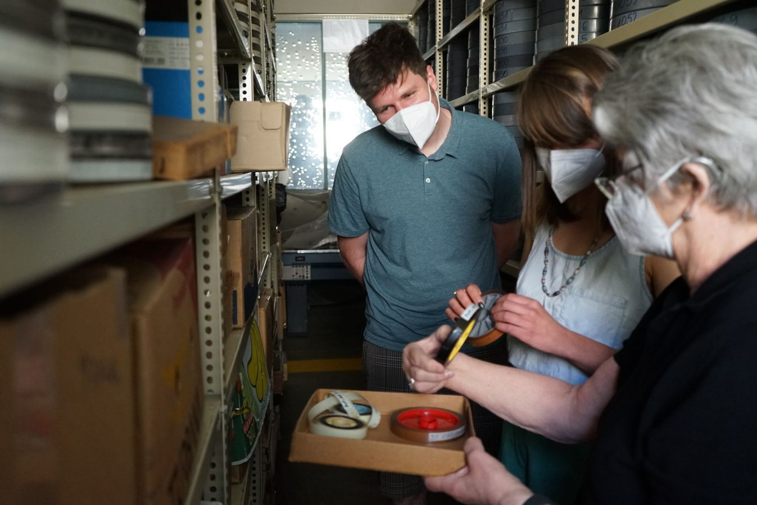
Why researching knowledge sharing in audiovisual archives?
Colleagues with a lot of experience can have tacit or implicit knowledge that is embodied within their experience, they might not be fully aware of it and therefore they might not know how to share this knowledge exactly. For us, it can be difficult to know what questions to ask.
We wondered how to apply the methods, standards, and theory we learned elsewhere and during our studies, such as knowledge about new technologies, or ideas about improved standards and methods.
Edith Schlemmer, long term archivist at the Austrian Film Museum, explaining how to identify the production elements used for newsreels to Florian Haag and Nadja Šičarov.

Slide 4
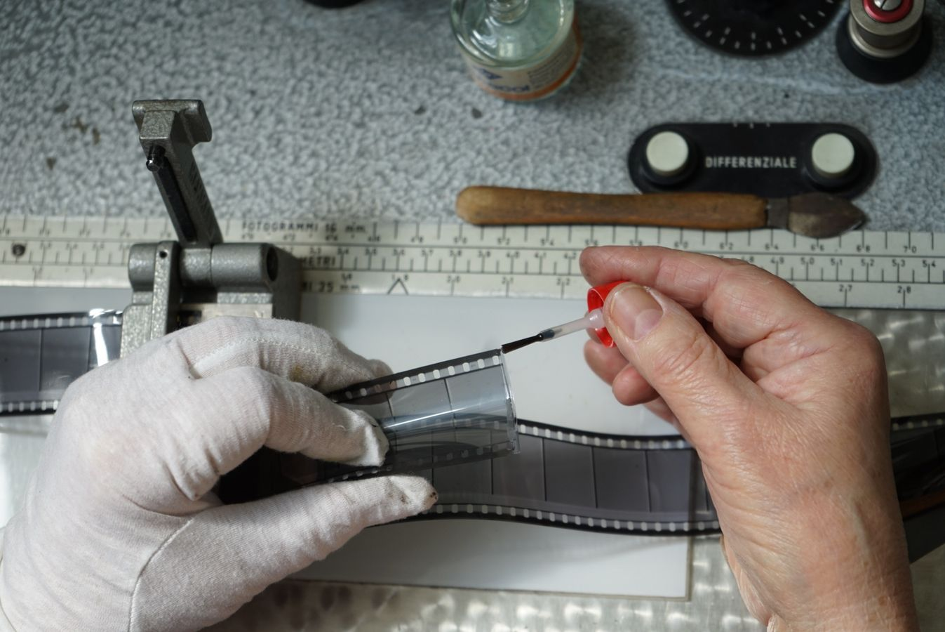
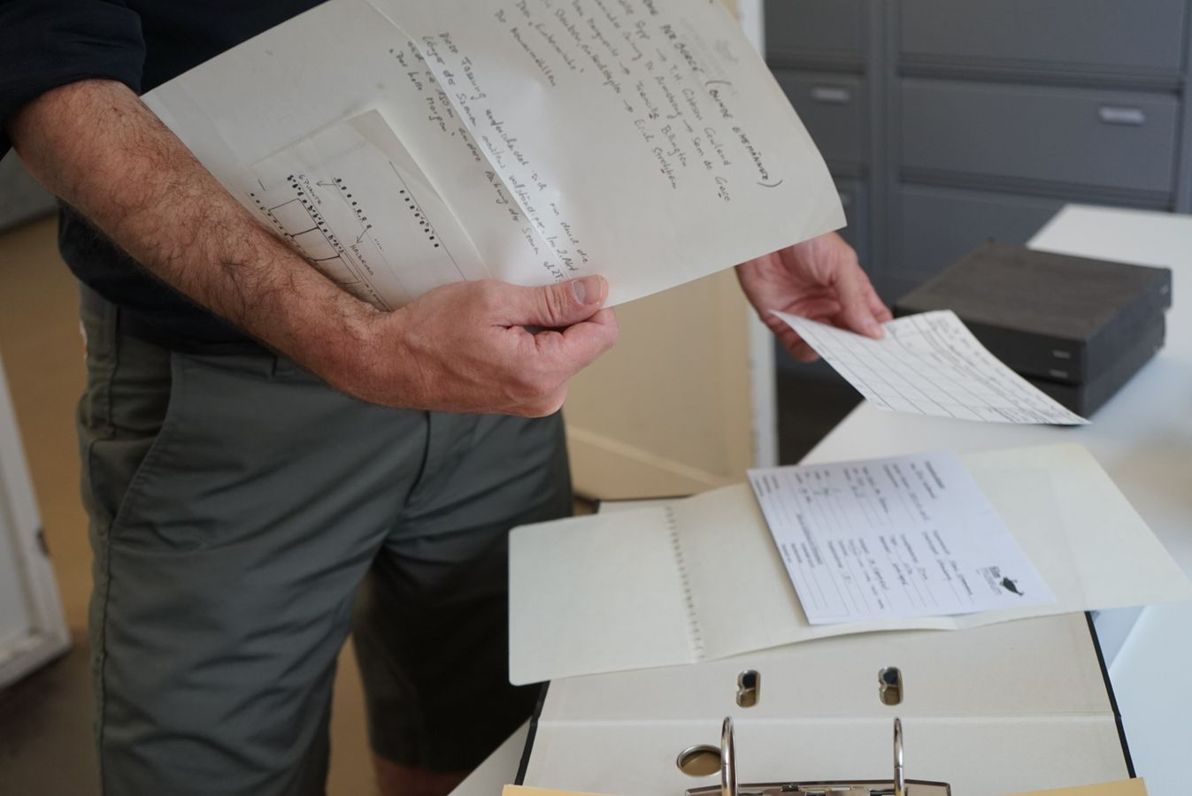
Our questions
How can our more experienced colleagues share their valuable knowledge gained through years of practice and experience with us?
How can we bring in "new" knowledge and learn from our senior colleagues at the same time?
How can we facilitate the exchange of knowledge between different generations of audiovisual archivists?
Experienced hands make a cement splice
Deciphering the handwriting of colleagues in the technical reports of film elements

Slide 5
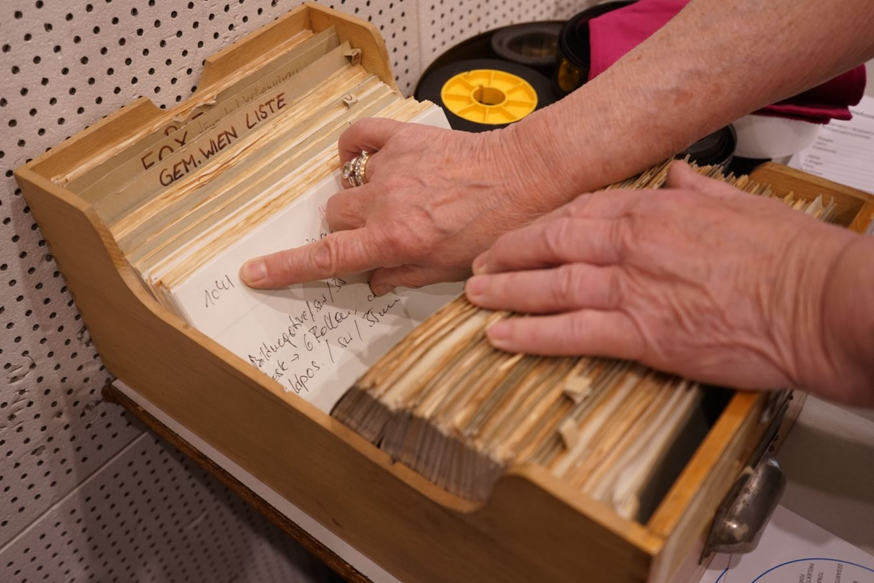
Some knowledge transfer challenges
  How to recognizing and pass on collection knowledge of people with long tenure to new generations of archivists?
  How to facilitate exchange of collection knowledge between communities, researchers, and archivists?
  How to better share collection knowledge between curatorial and archival departments?
  How to share knowledge about past preservation activities and embed them in existing documentation practices, to secure understanding and continuity of practices?
  How to pass on and preserve technical knowledge and skills when there are only a few specialists left and no one to take over or no education available?
  How to share an understanding of the importance of AV preservation with funding bodies, and colleagues?
  How to use standards and guidelines produced within the international community of AV archives, and overcome a possible language barrier?
  How to create new knowledge about audiovisual practices, when there is a lack of necessary knowledge and expertise in the region?
Edith Schlemmer going through and explaining previous systems of collection documentation

Slide 6
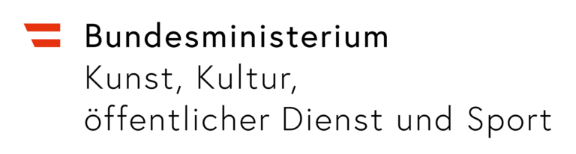
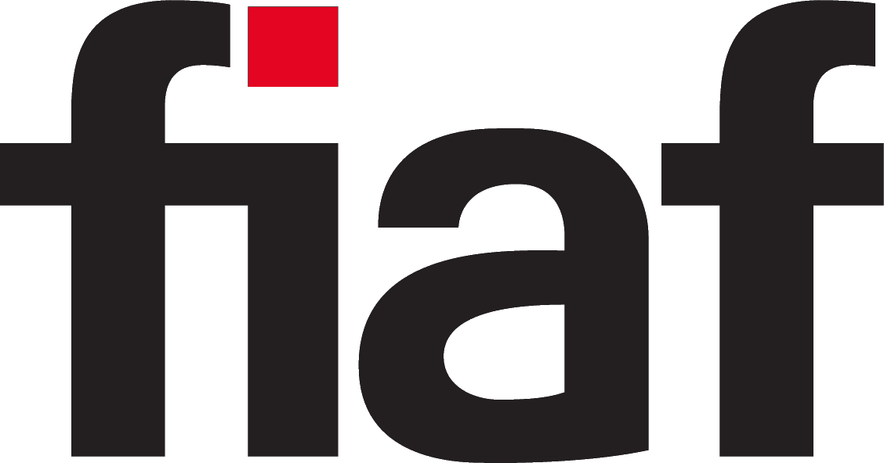
Share that Knowledge! Finding Strategies for Passing on Knowledge Across Generations of Audiovisual Archivists (2019-2023)
Working group Archive Affiliates
  Austrian Film Museum (Austria)
  Academic Film Center and Alternative Film Archive (Serbia)
  BFI National Archive (UK)
  Cinémathèque québécoise (Canada)
  Cineteca Nacional de México (Mexico)
  Imperial War Museum (UK)
  J.H. Kwabena Nketia Archives University of Ghana (Ghana)
  Library and Archives Canada (Canada)
  Národní filmový archiv (Czech Republic)
  National Film and Sound Archive (Australia)
  Netherlands Institute for Sound and Vision (The Netherlands)
  Slovenska kinoteka (Slovenia)
  Thai Film Archive (Thailand)
Expert advisors
  Research advisor on methods of qualitative research: Karen F. Gracy (Professor, School of Information, Kent State University)
  Group of experts

Slide 7
Share that Knowledge! Finding Strategies for Passing on Knowledge Across Generations of Audiovisual Archivists
Goal
  Develop strategies and methods of unlocking, articulating and sustaining the knowledge that archivists hold about the collections they work with
Objectives
  Conduct literature research and set up a theoretical framework for a qualitative research study of knowledge transfer
  Define the expert knowledge of audiovisual archivists
  Explore the methods of knowledge transfer within audiovisual archives
  Identify the challenges in transferring the expert knowledge of audiovisual archivists
  Formulate and disseminate successful strategies of knowledge transfer for audiovisual archives
Outcome
  Handbook for knowledge sharing within audiovisual archives
  Workshop/Symposium

Slide 8
Share that Knowledge! Finding Strategies for Passing on Knowledge Across Generations of Audiovisual Archivists
Research
Examples from other fields, but needed are specific methods for our field
Looking at practices: qualitative research methods
Collected data:
  86 interviews with colleagues about their knowledge sharing experience
  Interviewees with different positions: audiovisual archivists, technicians, managers, curators, etc.
  Transcribed, analysed using grounded theory methods
  Patterns of types of knowledge at risk, challenges of sharing this knowledge, and practiced methods
  Translated research findings into this road map

Slide 9
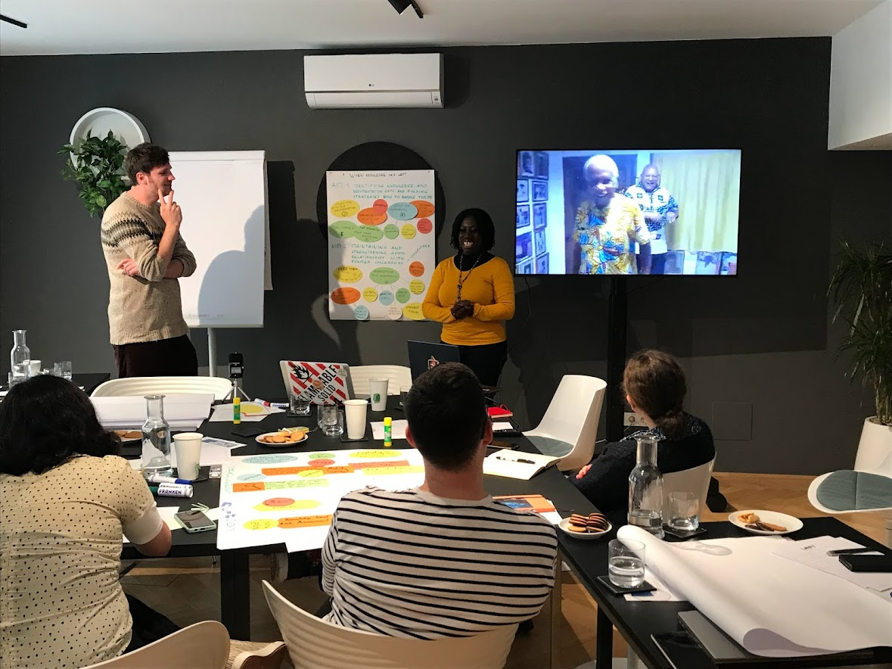
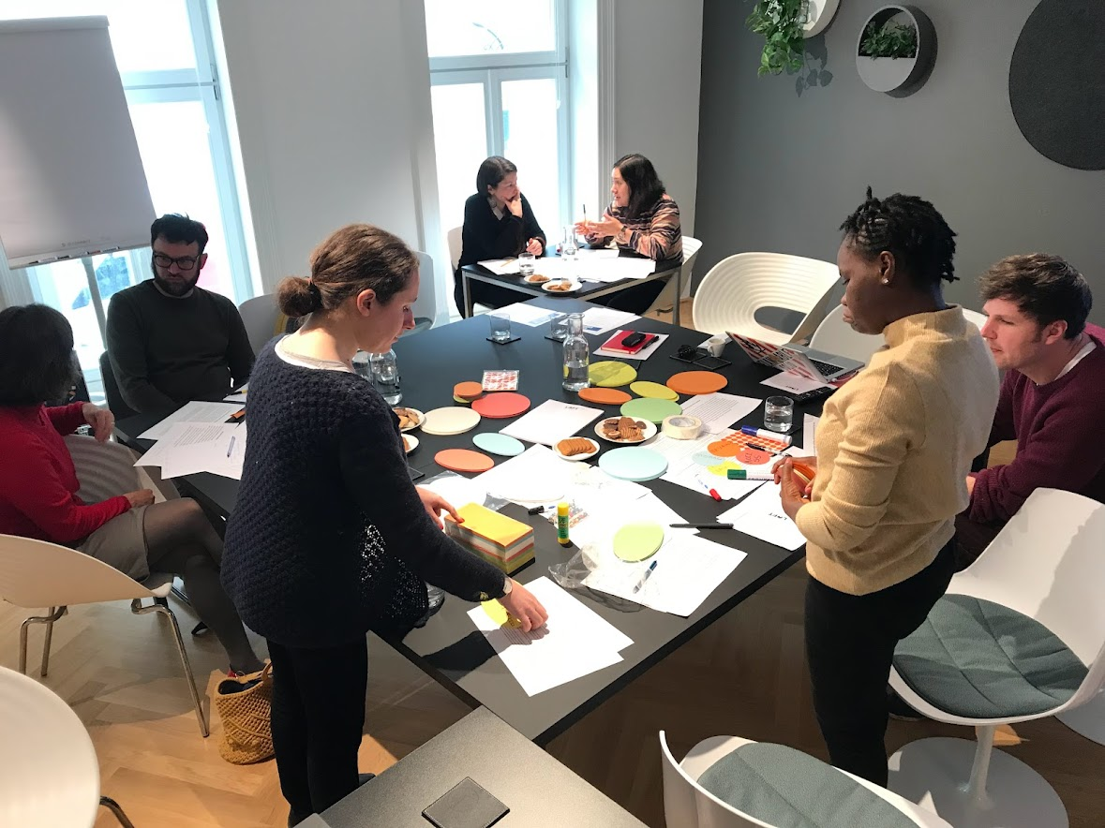
Workshop in Vienna, March 2023

Slide 10
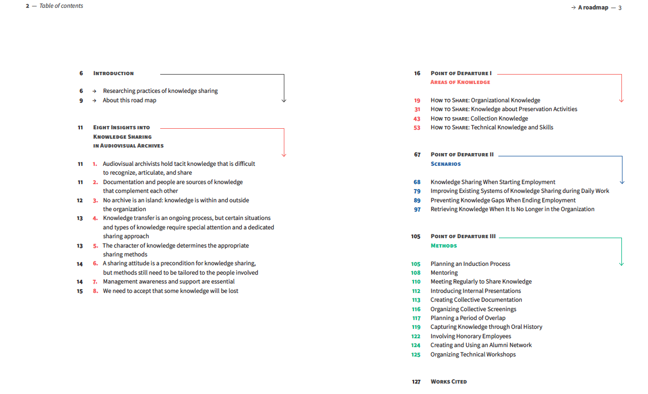
The main outcome of the research: Share That Knowledge! A Road Map for Sharing Knowledge across Generations of Audiovisual Archivists

Slide 11
Structure of the book
Share That Knowledge! A Road Map for Sharing Knowledge across Generations of Audiovisual Archivists
Introduction
Eight insights into knowledge sharing
Point of departure I: Areas of knowledge
Point of departure II: Scenarios
Point of departure II: Methods

Slide 12
Eight insights into knowledge sharing
Audiovisual archivists hold tacit knowledge that is difficult to recognize, articulate, and share
Documentation and people are sources of knowledge that complement each other
No archive is an island: knowledge is within and outside the organization
Knowledge transfer is an ongoing process, but certain situations and types of knowledge require special attention and a dedicated sharing approach
The character of knowledge determines the appropriate sharing methods
A sharing attitude is a precondition for knowledge sharing, but methods still need to be tailored to the people involved
Management awareness and support are essential
We need to accept that some knowledge will be lost

Slide 13
Structure of the book
Share That Knowledge! A Road Map for Sharing Knowledge across Generations of Audiovisual Archivists
Point of departure I: Areas of knowledge
Organizational knowledge
Knowledge about preservation activities
Collection knowledge
Technological knowledge and skills
Point of departure II: Scenarios
When starting employment
During daily work
When ending employment
When knowledge is no longer at the organization
Point of departure III: Methods

Slide 14
Workshop IASA 14th September, 2023
Participants are grouped into five groups. Each group will together work on one knowledge sharing exercise:
How to Share: Knowledge about Preservation Activities
How to Share: Technical Knowledge and Skills
Improving Existing Systems of Knowledge Sharing during Daily Work
Preventing Knowledge Gaps When Ending Employment
Retrieving Knowledge When It Is No Longer in the Organization
At the end of the workshop, we would like to have a discussion about the knowledge sharing challenges and methods. To start the discussion, each group will share one knowledge sharing method formulated in your exercise.
9:45 – 10:30 - group work
10:30 – 11:00 - break
10:30 – 11:30 - group work
11:30 – 12:00 - discussion

Slide 15
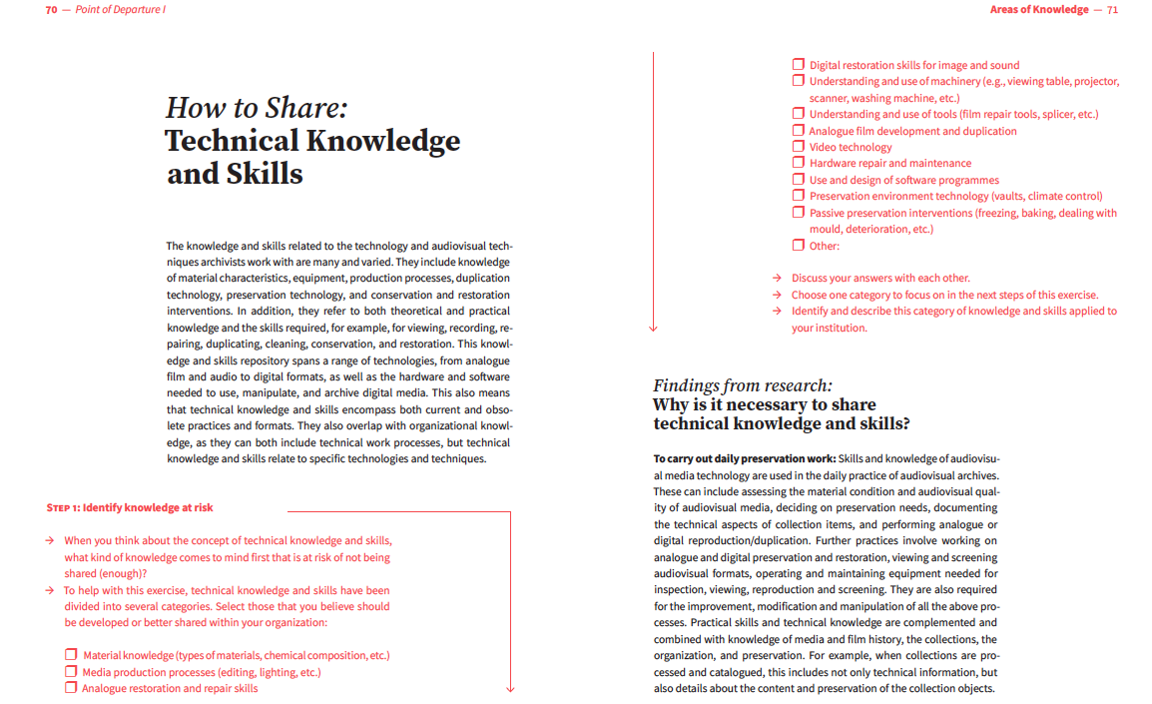

Slide 16
Knowledge sharing methods we identified in the research project
Mentoring
Meeting Regularly to Share Knowledge
Introducing Internal Presentations
Creating Collective Documentation
Organizing Collective Screenings
Planning a Period of Overlap
Capturing Knowledge through Oral History
Involving Honorary Employees
Creating and Using an Alumni Network
Organizing Technical Workshops

